Slide 1



SOFTWARE ARCHITECTURE
JUAN DIEGO PINZÓN FONTECHA
Carlos Felipe Avilan Payares
Juan Esteban Agredo Santamaria

Slide 2


IDEA 1
LAW FIRM

Slide 3


PROBLEM:
LAW FIRMS OFTEN MANAGE THEIR CASES AND CLIENTS WITH MULTIPLE NON-INTEGRATED TOOLS (EXCEL, EMAILS, PHYSICAL AGENDAS). THIS GENERATES CLUTTER, ERRORS IN LEGAL DEADLINES AND BILLING DIFFICULTIES.

Slide 4


GENERAL DEFINITION:
SOLUTION OFFERED:
JUSTIFICATION:
An ERP specifically designed for law firms that includes modules for client management (CRM), docket control, hearing scheduling and deadlines, billing and payment tracking.
This ERP will allow lawyers to optimize their case management, improve communication with clients and automate administrative processes, saving time and reducing human errors.
END CUSTOMER:
UTILITY:
Small, medium and large law firms.
Independent lawyers handling multiple cases.
Corporate legal departments that need to organize their legal affairs.
Monetization through licensing or SaaS model with monthly or annual subscription.
Additional services such as customization, technical support and secure cloud storage.

Slide 5



ADVANTAGES
DISADVANTAGES
AUTOMATION OF ADMINISTRATIVE PROCESSES:
Centralized client and case management.
Time optimization:
Regulatory compliance:
Security and confidentiality:
RESISTANCE TO CHANGE:
COST OF IMPLEMENTATION:
LEARNING CURVE:
ADAPTABILITY TO DIFFERENT AREAS OF LAW:

Slide 6
FUNCTIONAL REQUIREMENTS
CLIENT MANAGEMENT MODULE (LEGAL CRM)
RF01: THE SYSTEM MUST ALLOW TO REGISTER AND MANAGE CLIENT INFORMATION (NAME, CONTACT, CASE HISTORY).
RF02: IT MUST STORE AND ORGANIZE LEGAL DOCUMENTATION FOR EACH CLIENT.
RF03: ALLOW THE CLASSIFICATION OF CLIENTS ACCORDING TO TYPE OF LEGAL SERVICE (CRIMINAL, CIVIL, COMMERCIAL, ETC.).
RF04: SEND AUTOMATIC NOTIFICATIONS TO CLIENTS ABOUT PROGRESS IN THEIR CASES OR SCHEDULED APPOINTMENTS.
2. CASE AND DOCKET MANAGEMENT MODULE
RF05: CREATE AND MANAGE LEGAL FILES, LINKING THEM TO CLIENTS AND RESPONSIBLE LAWYERS.
RF06: ENABLE THE UPLOAD AND STORAGE OF LEGAL DOCUMENTS ASSOCIATED WITH EACH CASE FILE.
RF07: ASSIGN TASKS AND REMINDERS TO LAWYERS AND PARALEGALS ABOUT DEADLINES AND KEY DATES.
RF08: MANAGE CASE STATUS (ACTIVE, UNDER REVIEW, CLOSED).
RF09: ALLOW SEARCH AND FILTERING OF FILES BY CLIENT, CASE TYPE OR STATUS.

Slide 7
FUNCTIONAL REQUIREMENTS
3. SCHEDULING AND APPOINTMENT MANAGEMENT MODULE
RF10: Register and manage appointments with clients, audiences and internal meetings.
RF11: Synchronize the agenda with external calendars such as Google Calendar or Outlook.
RF12: Send automatic reminders to lawyers and clients about scheduled appointments.
4. INVOICING AND FINANCE MODULE
RF13: GENERATE INVOICES FOR LEGAL FEES AND SERVICES, WITH AUTOMATIC TAX CALCULATION.
RF14: RECORD PAYMENTS MADE BY CLIENTS AND GENERATE FINANCIAL REPORTS.
RF15: INTEGRATE DIFFERENT PAYMENT METHODS (TRANSFERS, CREDIT CARDS, PAYPAL).
RF16: MANAGE INVOICING STATUS (PAID, PENDING, OVERDUE).

Slide 8
FUNCTIONAL REQUIREMENTS
5. Time and Task Tracking Module
RF17: Record the time spent by each lawyer on a specific case.
RF18: Generate reports of hours worked by each lawyer and legal team.
RF19: Assign tasks to lawyers and paralegals, with due dates and priorities.
6. Security and Access Module
RF20: Implement user roles with different access levels (lawyer, administrator, client).
RF21: Encrypt sensitive information and restrict access to documents according to permissions.
RF22: Record an audit history of all actions performed in the system.
7. Reporting and Analysis Module
RF23: Generate reports on active cases, income, billing and work times.
RF24: Allow export of reports in PDF and Excel formats.
RF25: Display metrics in a dashboard with graphs and business trends.

Slide 9

NON-FUNCTIONAL REQUIREMENTS
1
Performance and Scalability
RNF01: The system must support at least 100 concurrent users without performance degradation.
RNF02: System response should not exceed 2 seconds for queries and searches.
RNF03: It must allow scalability to add new modules without affecting performance.
3
Usability and User Experience
RNF08: The interface should be intuitive and accessible to users without advanced technical knowledge.
RNF09: It must be compatible with modern browsers such as Chrome, Firefox and Edge.
RNF10: The system must have a responsive design for use on mobile devices.
2
4
Security and Confidentiality
RNF04: All information must be stored with encryption.
RNF05: Access to files and documents must be based on roles and permissions.
RNF06: There must be two-factor authentication (2FA) for users with access to confidential information.
RNF07: Logs of access and modifications to files must be recorded.
Availability and Reliability
RNF11: The ERP must have an availability of 99.9% per year.
RNF12: It must have an automatic database backup system every 24 hours.
RNF13: In case of system failure, data recovery should not take more than 1 hour.

Slide 10
NON-FUNCTIONAL REQUIREMENTS
5
Compatibility and Integration
RNF14: The system must integrate with Google Calendar and Outlook for appointment management.
RNF15: It must be compatible with local electronic invoicing systems.
RNF16: It must allow data export in standard formats such as PDF and Excel.
6
Maintenance and Upgrades
RNF17: The system must allow upgrades without affecting operability.
RNF18: New versions must be tested in a test environment prior to implementation.
RNF19: Technical and user documentation must be available online.
7
Regulations and Compliance
RNF20: The ERP must comply with data protection regulations.
RNF21: Data must be stored on servers that comply with the legal security standards of the country where the firm operates.
RNF22: It must allow data auditing to ensure compliance with legal regulations.

Slide 11



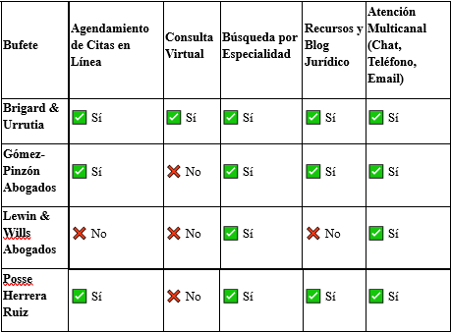


COMPARATIVE TABLE

Slide 12

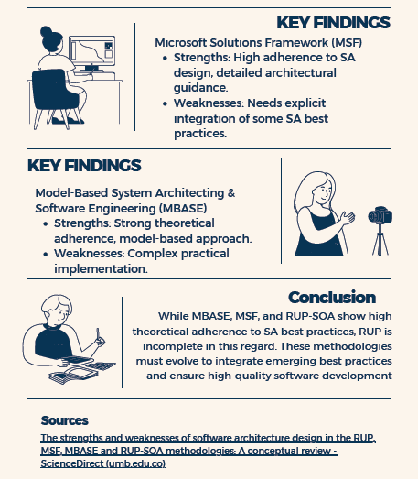
INFOGRAPHICS

Slide 13
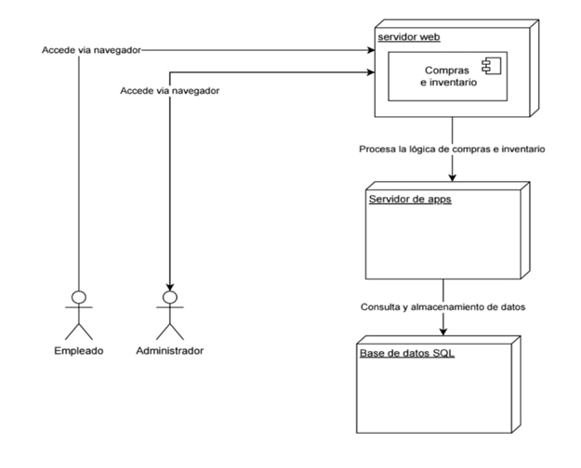
DIAGRAMA DE DESPLIEGUE MÓDULO COMPRAS/INVENTARIO

Slide 14
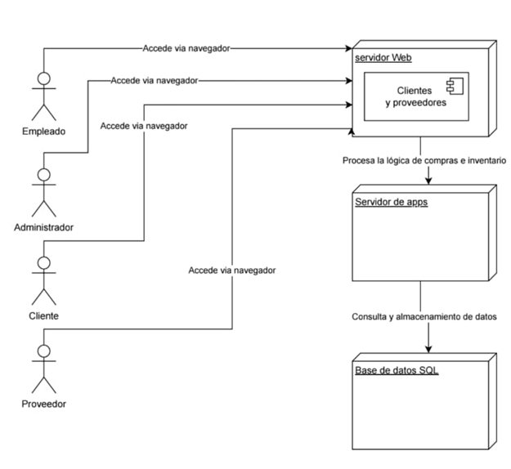
DIAGRAMA DE DESPLIEGUE MÓDULO CLIENTES/PROVEEDORES

Slide 15
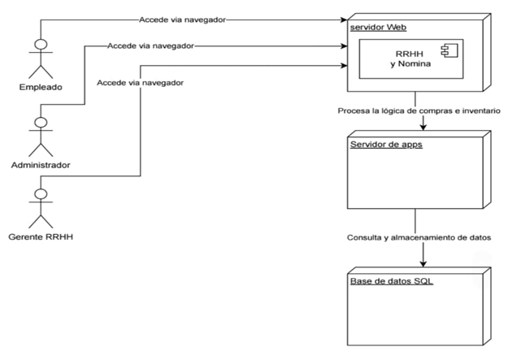
DIAGRAMA DE DESPLIEGUE MÓDULO RRHH/NÓMINA

Slide 16
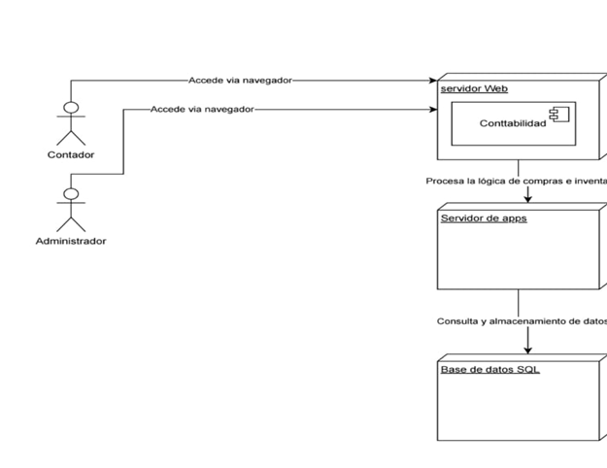
DIAGRAMA DE DESPLIEGUE MÓDULO CONTABILIDAD

Slide 17
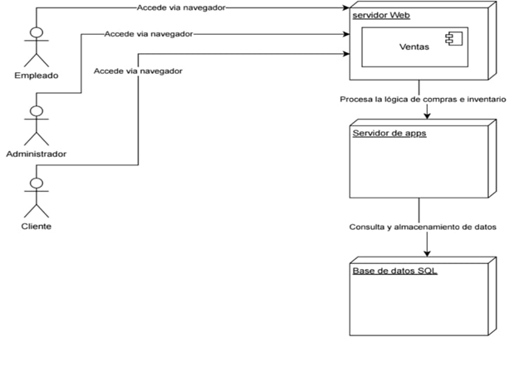
DIAGRAMA DE DESPLIEGUE MÓDULO VENTAS

Slide 18
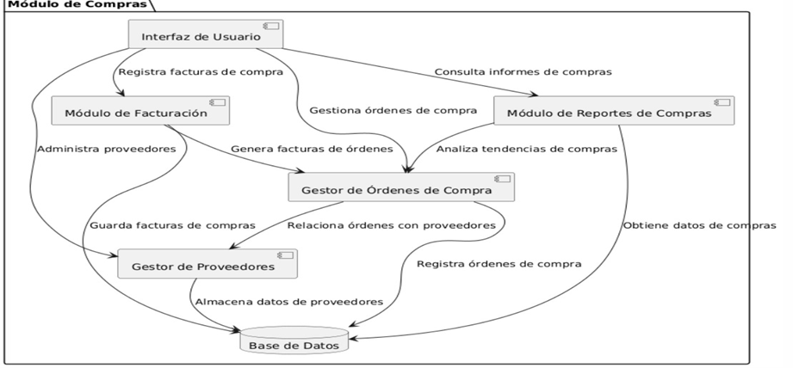
DIAGRAMA DE ESTRUCTURA COMPUESTA MÓDULO DE COMPRA/INVENTARIO

Slide 19
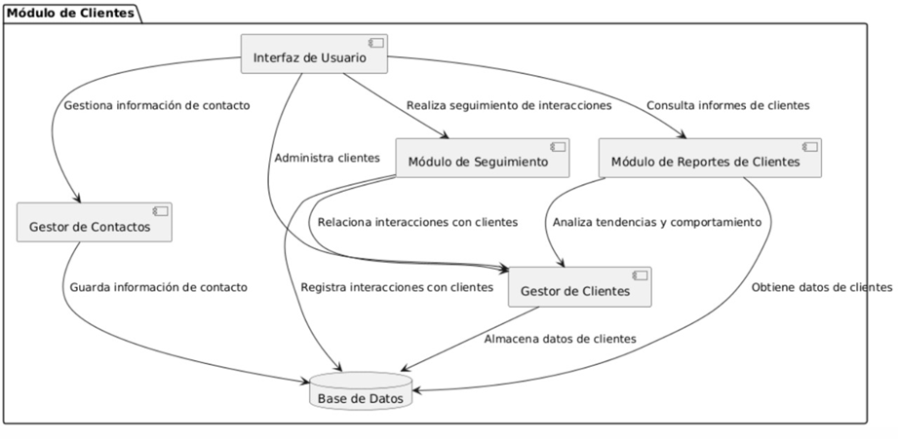
DIAGRAMA DE ESTRUCTURA COMPUESTA MÓDULO DE CLIENTES/PROVEEDORES

Slide 20
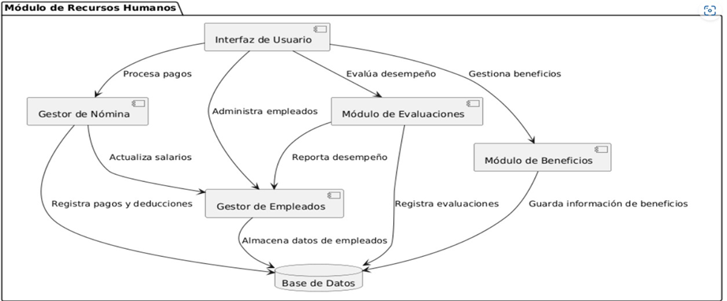
DIAGRAMA DE ESTRUCTURA COMPUESTA MÓDULO DE RRHH/NÓMINA

Slide 21
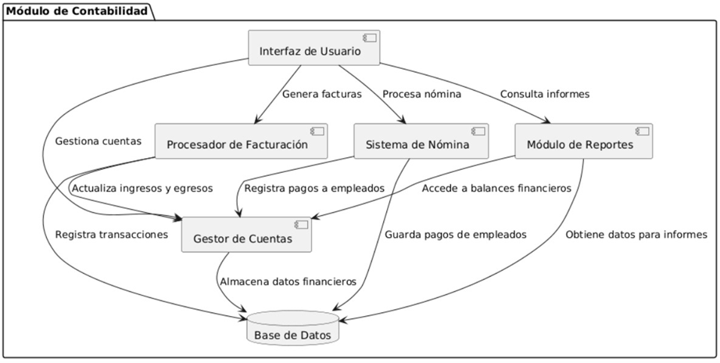
DIAGRAMA DE ESTRUCTURA COMPUESTA MÓDULO DE CONTABILIDAD

Slide 22
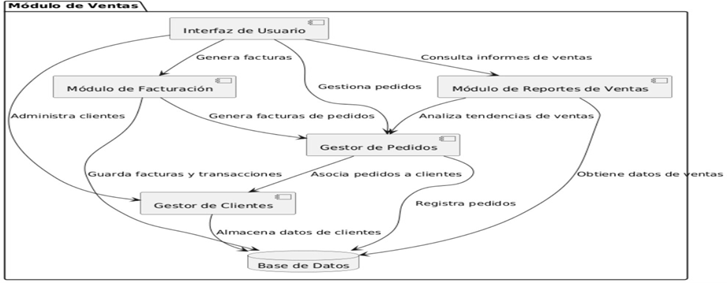
DIAGRAMA DE ESTRUCTURA COMPUESTA MÓDULO DE VENTAS

Slide 23
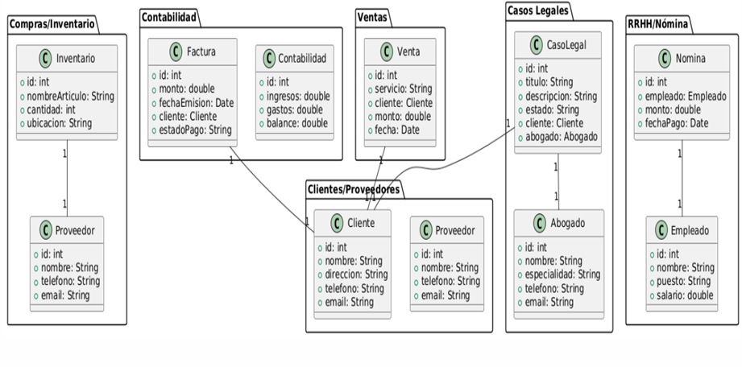
DIAGRAMA DE CLASES UNIFICADO ERP BUFETE ABOGADOS

Slide 24
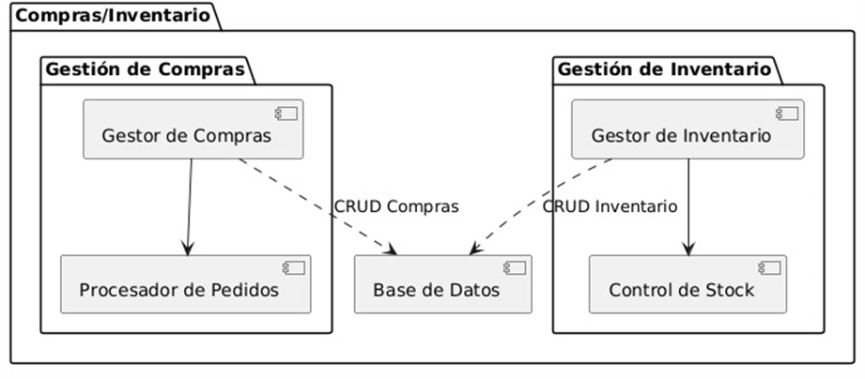
DIAGRAMA DE PAQUETES MÓDULO COMPRAS/INVENTARIO

Slide 25
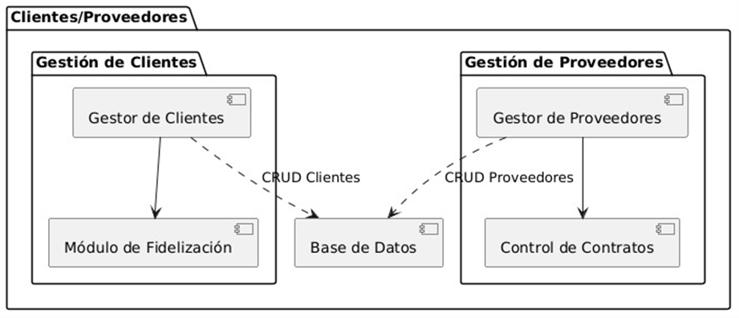
DIAGRAMA DE PAQUETES MÓDULO CLIENTES/PROVEEDORES

Slide 26
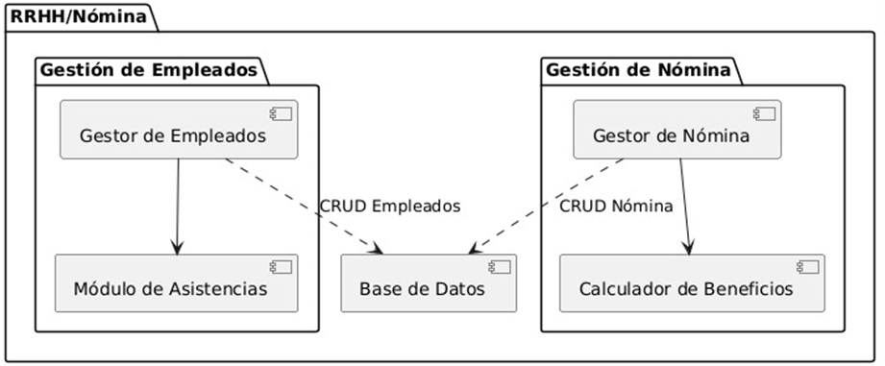
DIAGRAMA DE PAQUETES MÓDULO RRHH/NÓMINA

Slide 27
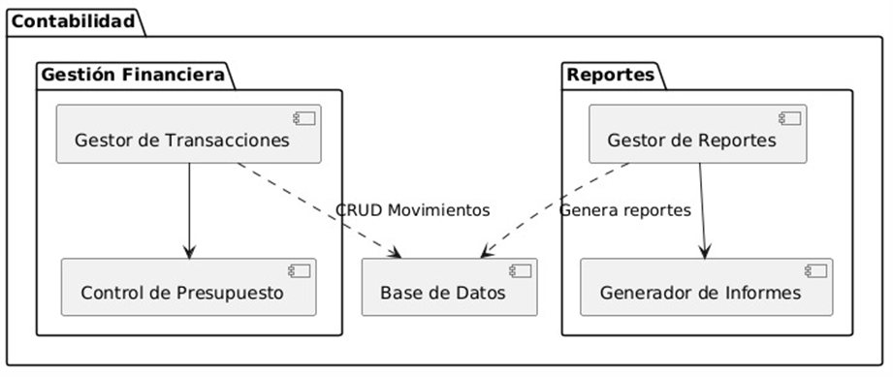
DIAGRAMA DE PAQUETES MÓDULO CONTABILIDAD

Slide 28
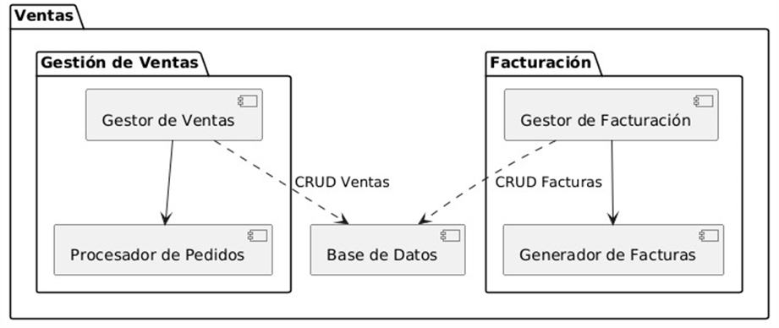
DIAGRAMA DE PAQUETES MÓDULO VENTAS

Slide 29
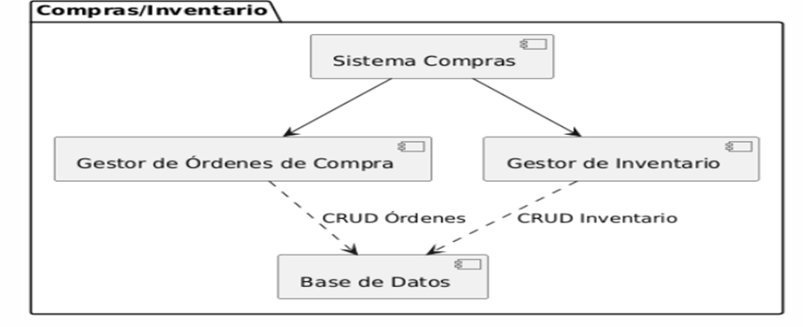
DIAGRAMA DE COMPONENTES MÓDULO COMPRAS/ INVENTARIO

Slide 30
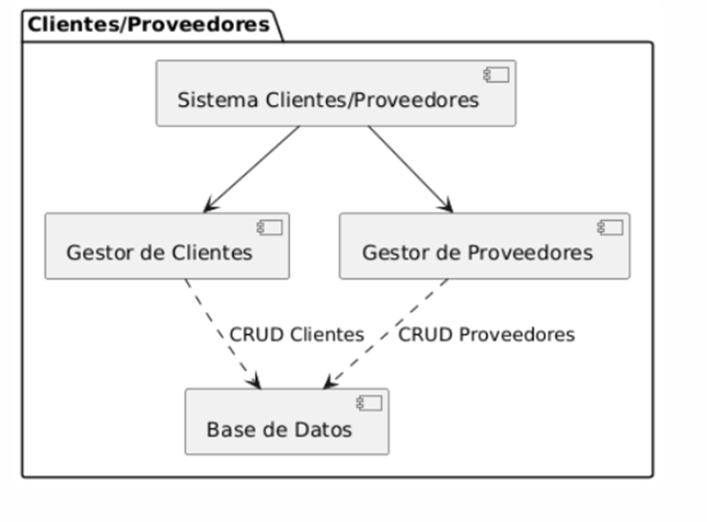
DIAGRAMA DE COMPONENTES MÓDULO CLIENTES/ PROVEEDORES

Slide 31
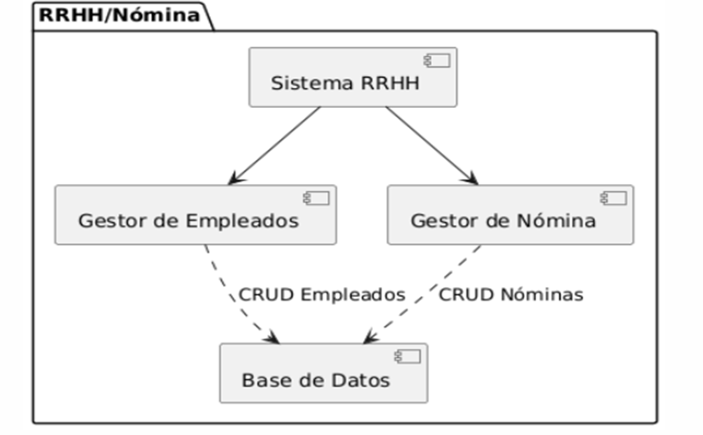
DIAGRAMA DE COMPONENTES MÓDULO RRHH/ NÓMINA

Slide 32
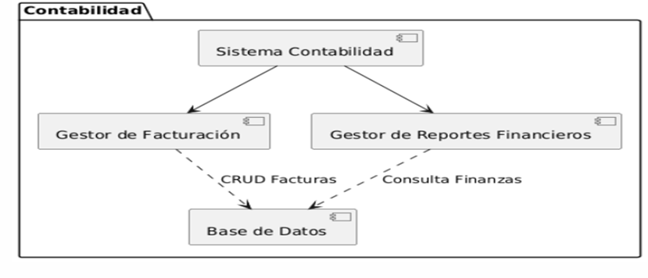
DIAGRAMA DE COMPONENTES MÓDULO CONTABILIDAD

Slide 33
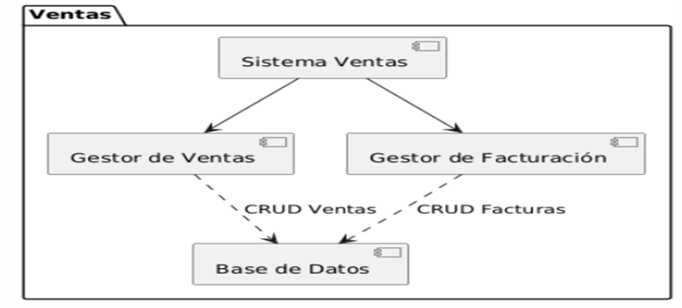
DIAGRAMA DE COMPONENTES DE USO MÓDULO VENTAS

Slide 34
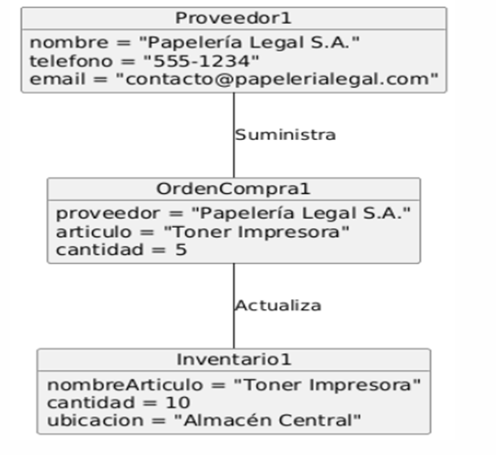
DIAGRAMA DE OBJETOS MÓDULOS COMPRAS/INVENTARIO

Slide 35
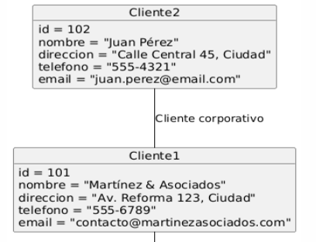
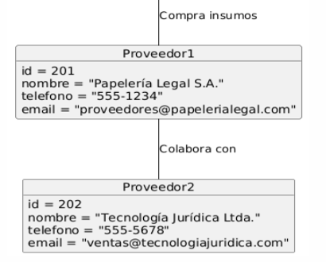
DIAGRAMA DE OBJETOS MÓDULOS CLIENTES/PROVEEDORES

Slide 36
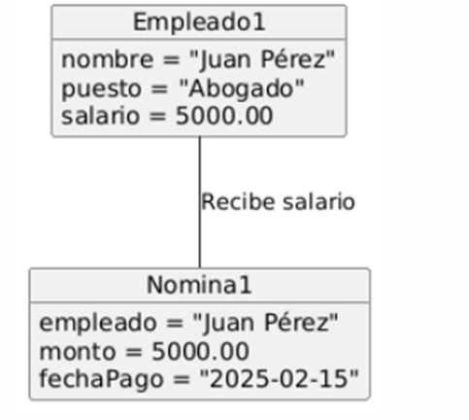
DIAGRAMA DE OBJETOS MÓDULOS RRHH/NÓMINA

Slide 37
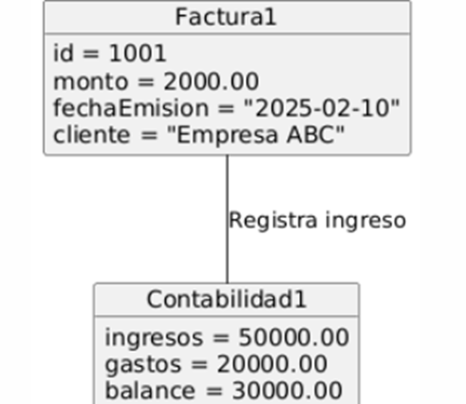
DIAGRAMA DE OBJETOS MÓDULO CONTABILIDAD

Slide 38
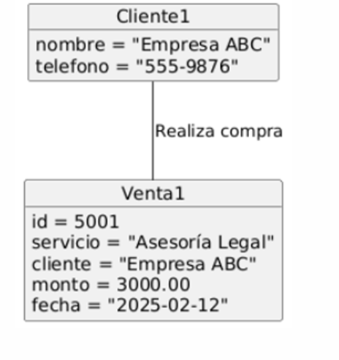
DIAGRAMA DE OBJETOS MÓDULO VENTAS

Slide 39
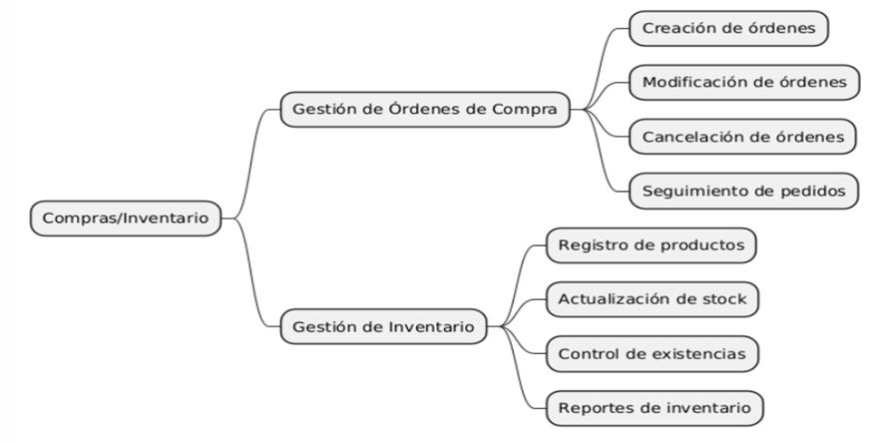
ÁRBOL DE DESCOMPOSICIÓN FUNCIONAL DE MÓDULO COMPRA/INVENTARIO

Slide 40

ÁRBOL DE DESCOMPOSICIÓN FUNCIONAL DE MÓDULO CLIENTES/PROVEEDORES

Slide 41
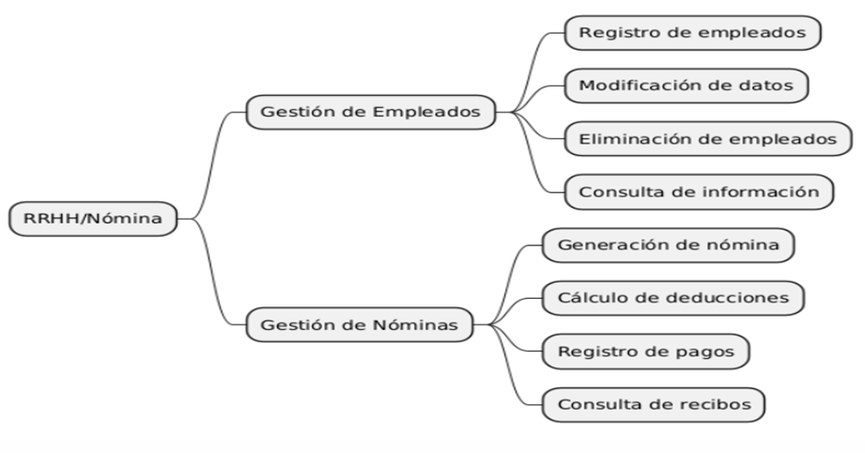
ÁRBOL DE DESCOMPOSICIÓN FUNCIONAL DE MÓDULO RRHH/NÓMINA

Slide 42
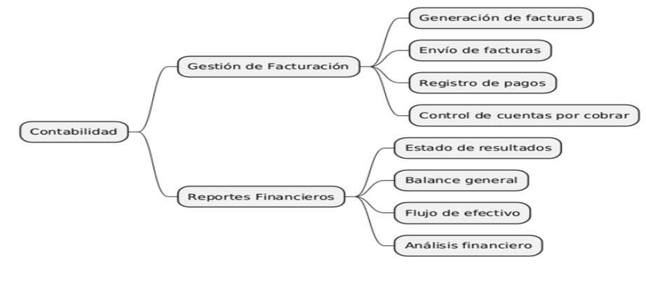
ÁRBOL DE DESCOMPOSICIÓN FUNCIONAL DE MÓDULO CONTABILIDAD

Slide 43
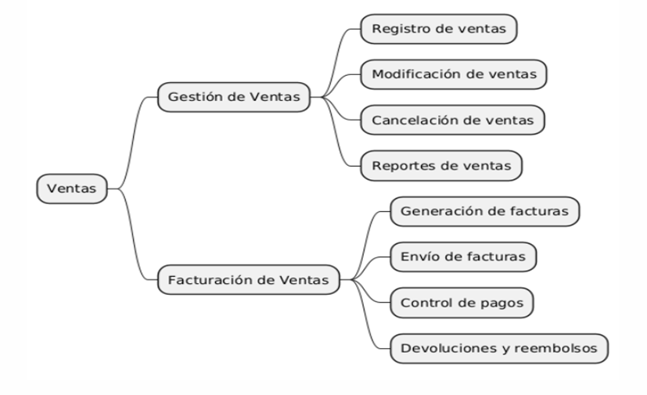
ÁRBOL DE DESCOMPOSICIÓN FUNCIONAL DE MÓDULO VENTAS

